Slide 1




NEXT GEN EMPLOYABILITY PROGRAM
Creating a future-ready workforce
Team Members
College Name
Student Name :BLESSY.G
Student ID : au960221104045
Arunachala College Of Engineering For Women

Slide 2

CAPSTONE PROJECT SHOWCASE
Project Title
Car Rentals Application with Django Framework
Abstract | Problem Statement | Project Overview | Proposed Solution | Technology Used | Modelling & Results | Conclusion

Slide 3
Abstract:
Our Aim is to design and create a data management System for a car rental company.This enables admin can rent a vehicle that can be used by a customer This system increasescustomer retention and simplify vehicle and staff Management in an efficient way.This software car Rental System has a very user friendly interface. Thus the users willfeel very easy to work on it. By using this system admin can manage customer confirm andcancel booking request, customer Testimonials, customer issues. The car information can beadded to the system. Or existed car information can be edited or deleted too by Administrator.There is no delay in the availability of any car information, whenever needed, car informationcan be Captured very quickly and easilOur Aim is to design and create a data management System for a car rental company. This abstract provides a high-level overview of the car rental application built with Django.
Source :

Slide 4
Problem Statement:
The Manual car rental system provides services only during office hours. So customers have limited time to make any transactions or reservations of the cars. The existence of the online car rental systems nowadays has overcome the limitation of the business operation hour. Most of the systems offered reservation service for tourists or travelers. Besides that, there are some customers who faced a problem in choosing car to be rented which suitable with some of the important requirements,1. To rent a car a prospective renter must first go to the nearest office to register as a client.2. Cars that provide difficulties to rent out are normally advertised in local or national newspaper.It involves a lot of paperwork and consumes time.
Source :

Slide 5
Project Overview:
Online Car Rental System, the users will able for searching and reserving their favorite cars easily through the Internet and it can be accessed anytime. Hence, the company is able to improve their customer satisfaction level, increasing efficiency by provides better services to their customer
Source :

Slide 6
Proposed Solution:
.
In this car rental system we are going to introduce online booking of car rent will beavailable. So the Burdon of the customer will be reduced. Our Aim is to design and create a datamanagement System for a car rental company. This enables admin can rent a car that can be used by a customer. This system increases customer retention and simplify car and staff Managementin an efficient way
This software car Rental System has a very user friendly interface. Thus the users willfeel very easy to work on it. By using this system admin can manage customer confirmand cancel booking request, customer Testimonials, customer issues. The car informationcan be added to the system by admin
Source :

Slide 7
User Registration: Allow users to register an account with their personal information, contact details, and payment method
.● Vehicle Availability: Provide a mechanism for users to search and check the availability of vehicles based on location, date, and time
● Vehicle Booking: Allow users to select a vehicle, specify the rental period, and make a reservation.
● Reservation Management: Enable users to view, modify, and cancel their reservations.
● Online Payment: Integrate a secure payment gateway to facilitate online payment for vehicle rentals
Source :

Slide 8
Vehicle Pick-up and Return: Provide a process for users to pick up the reserved vehicle at the designated location and return it at the end of the rental period.
● Vehicle Inspection: Include a vehicle inspection process to assess and record the condition of the vehicle before and after the rental
● Customer Feedback: Allow users to provide feedback and ratings for the rentedvehicles and overall experience
Performance: Response times for user actions such as searching, booking, and payment should be within an acceptable range.
● Security: Implement strong security measures to protect user information and payment transactions.
● Usability: Provide clear instructions and guidance throughout the rental process
Source :

Slide 9


Technology Used
Front-end
Back-end
Source :

Slide 10
Modelling & Results:
We model and solve the car logistics problem on the basis of a rolling planning horizon of oneweek. Resulting plans are re-optimized each night on the basis of new data, assuming that allcheck-outs and check-ins are generally keyed into the information system not later than by theend of the day. The assumption of time periods of half days results in partitioning a week into14 periods. (Diﬀerent planning horizons or deﬁnitions of time buckets are of course possible.)We aim at a robust car logistics plan, which provides the stations in each period with enough carsof the diﬀerent car groups, without fully automating the detailed decisions in the stations duringthe course of the day. The station staﬀ should be enabled to handle customer requests by ﬂexiblydeploying locally available cars. That is, we do not propose an automatic assignment of speciﬁccars to customers by the decision support system
Source :

Slide 11
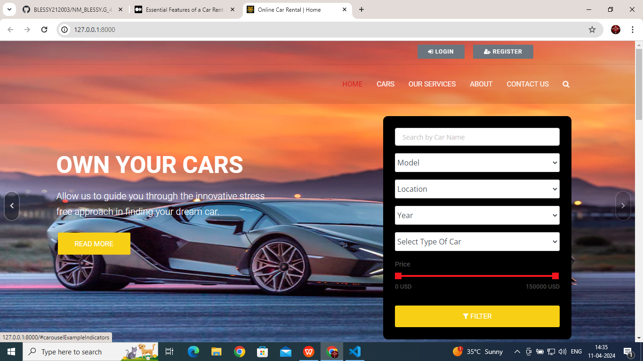
Homepage

Slide 12
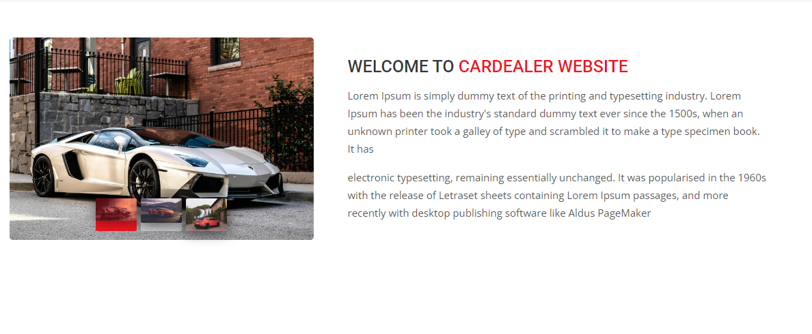
About-Us-Page

Slide 13
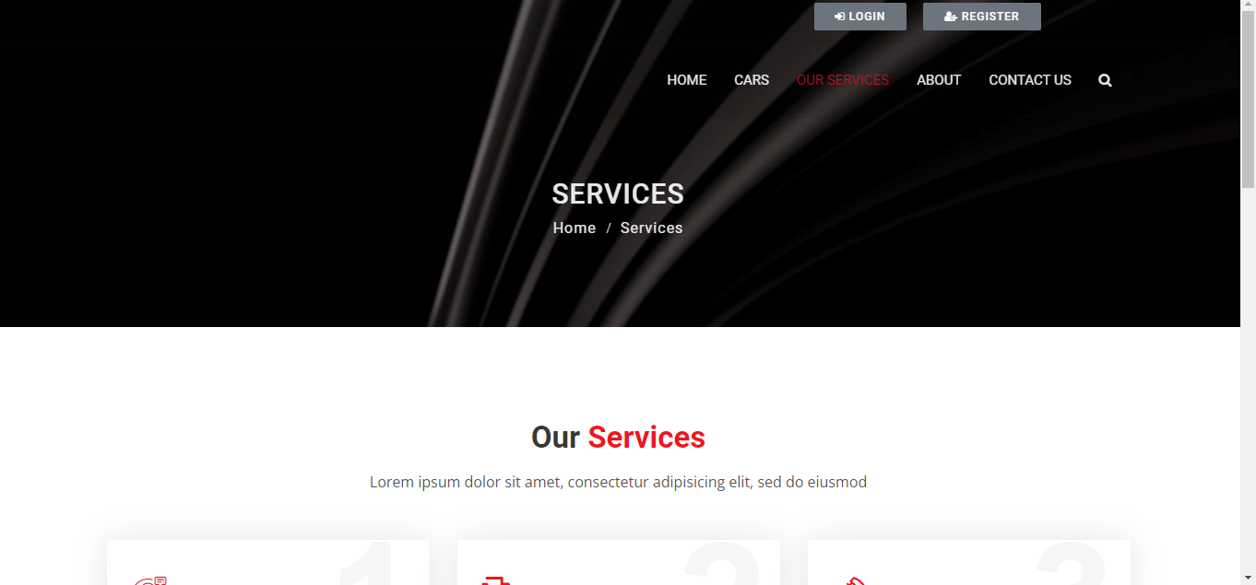
Service-Page

Slide 14
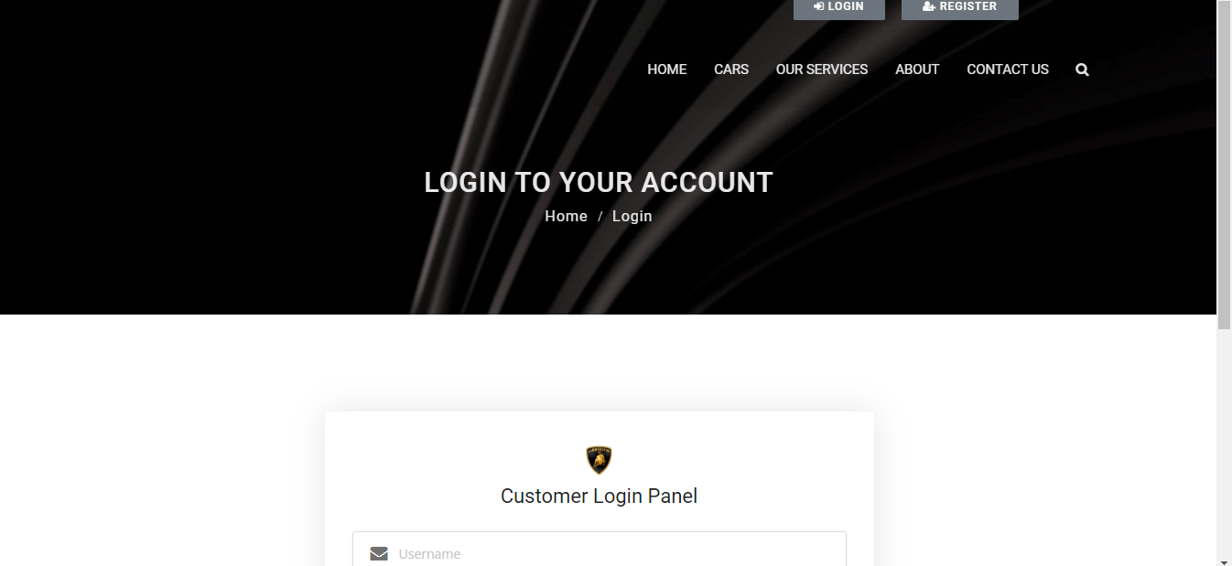
Login Page

Slide 15
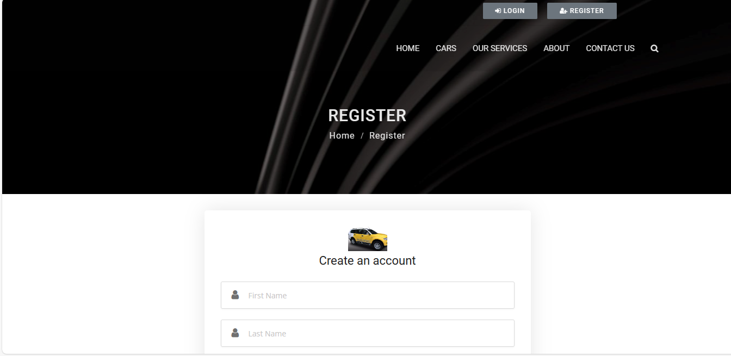
Register Page

Slide 16
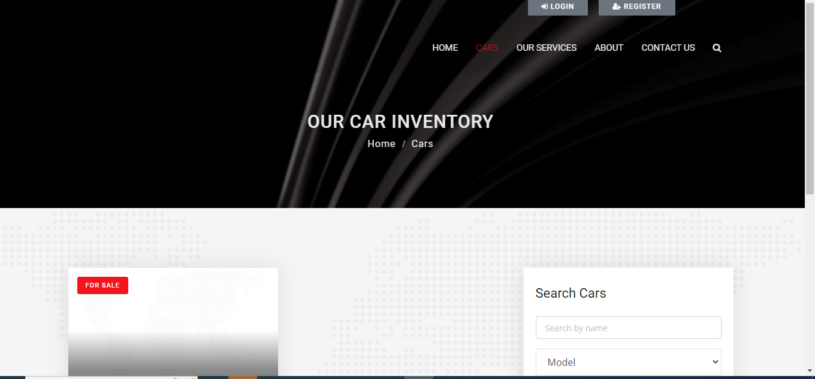
Our Car Inventory

Slide 17
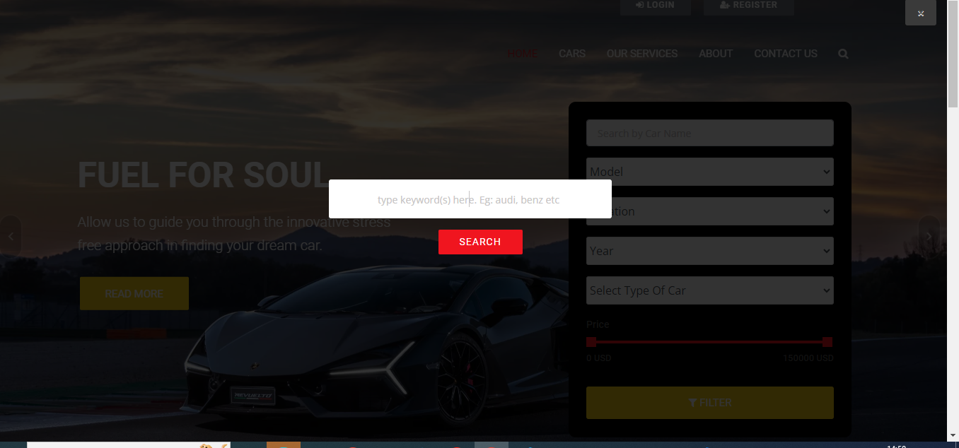
Search Page

Slide 18
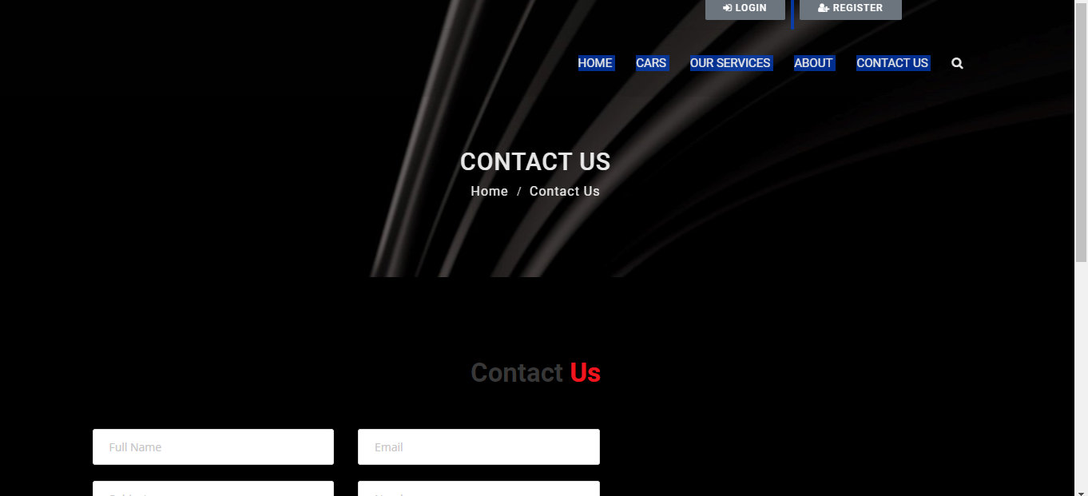
Contact Page

Slide 19
Future Enhancements:
After careful analysis of these software solutions, it becomes evident that robust car rental management software should encompass a comprehensive array of features. These features include facilitating seamless online reservations, streamlining fleet management processes, offering flexible package options, ensuring secure payment gateways, providing extensive reporting capabilities, enabling efficient invoicing functionalities, managing client accounts effectively, delivering timely notifications, supporting digital signature capabilities, integrating promo codes, and more.

Slide 20
Conclusion:
we presented a novel quantitative decision model to eﬃcientlysolve short-term car rental logistics problems by means of network ﬂow optimization. Our deci-sion model includes essential practical aspects such as multi-period planning, a country-widenetwork, speciﬁc transportation relations, ﬂeeting and deﬂeeting, and diﬀerent car groups
Source :

Slide 21
Thank You!
Notes:
Thank You !!

